Slide 1
Courant Math 2799.001
Modeling & Risk Mgt of Bonds & Securitized Products
Lecture 2: Passthroughs, Prepayment
April 1, 2024
Prof: Rodney Sunada-Wong rsw8@nyu.edu
TA: Edison Lee el2700@nyu.edu

Slide 2
Topics
More insight into leverage impact on markets
Homework Review
Agency Passthroughs, Guarantee Fees
TBA, Hedging with TBAs, Counterparty Credit Risk, Liquidity Risk
What happened in 2020
Specified Pools
Valuation (ignoring the impact of prepayment)
Sensitivities (ignoring the impact of prepayment)
Prepayment and Curtailment (basic)
Homework
APPENDIX: Amounts Issued

Slide 3
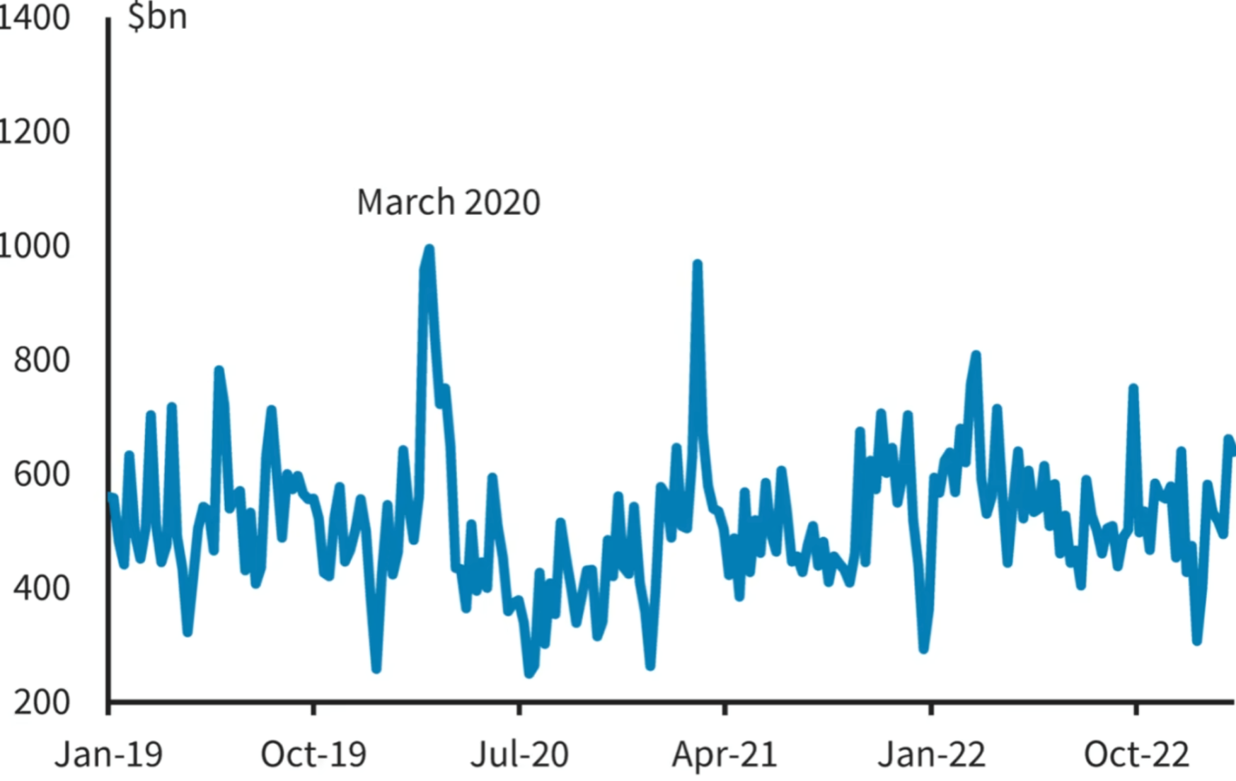
Market Insights: Treasury trading volume (March 2020)
Trading volume spiked >$1 trillion
Source: https://www.ft.com/content/5b5dacde-1a59-499b-acfd-e9a856b43255

Slide 4
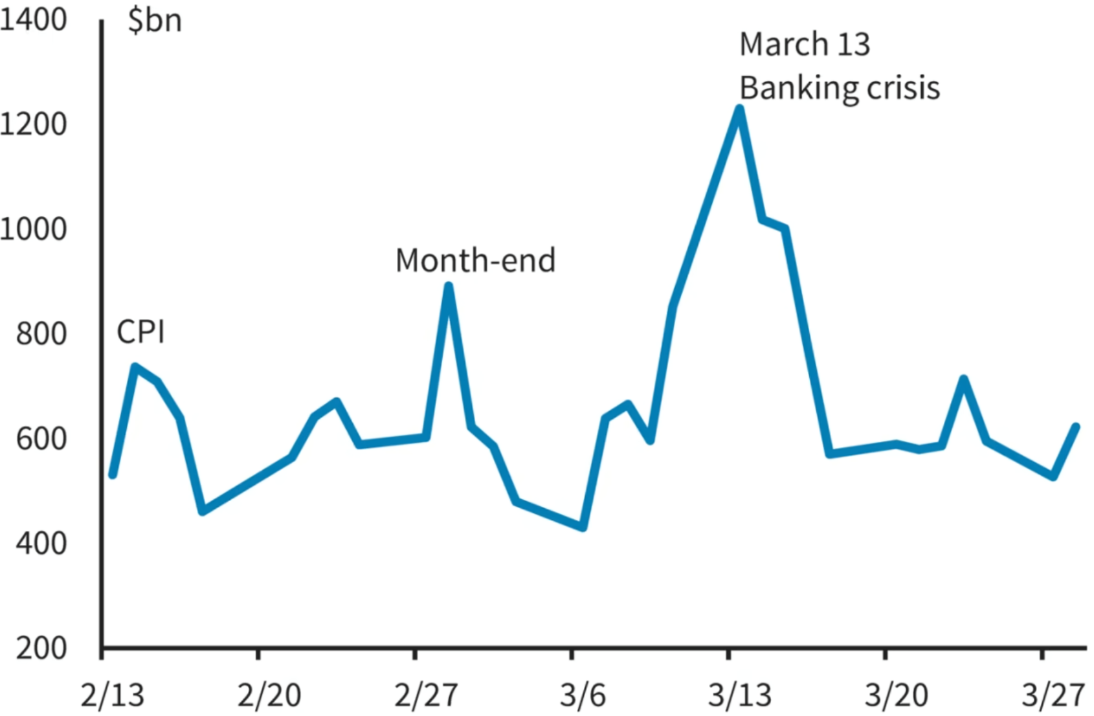
Market Insights: Treasury trading volume (March 2023)
Trading volume spiked >$1.2Trillion
Source: https://www.ft.com/content/5b5dacde-1a59-499b-acfd-e9a856b43255

Slide 5
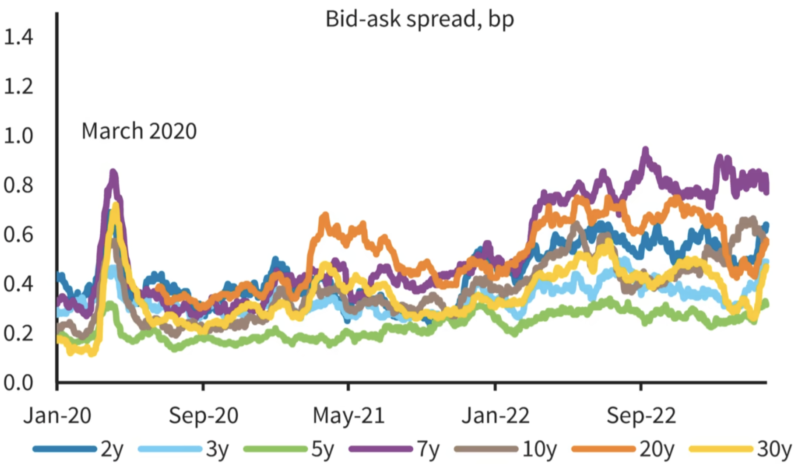
Market Insights: bid-ask spreads (2020 to 2023)
Bid-ask spreads spiked in Mar 2020, then tightened. Past 12mths: concerns about liquidity of Treasuries.
Source: https://www.ft.com/content/5b5dacde-1a59-499b-acfd-e9a856b43255

Slide 6
Market Insights: Treasury Futures “Basis Trades”
Normally, when futures diverge from the notes underlying them, investors can buy the “cheap” bonds and sell the futures to pocket the difference.
Because spreads are usually tiny, funds repo the treasuries to fund larger positions
leverage to boost returns
BUT, taking on leverage to boost returns means taking on greater risk
”Repo” (Re Purchase Agreement)
If Party A owns treasuries, and executes an ”overnight repo” with Party B:
Party A sells the treasuries to Party B and is obligated to buy the Treasuries back the next day
Party B lends cash to Party A and receives that cash plus interest the next day
Party B has thereby executed a “reverse repo” with Party A

Slide 7
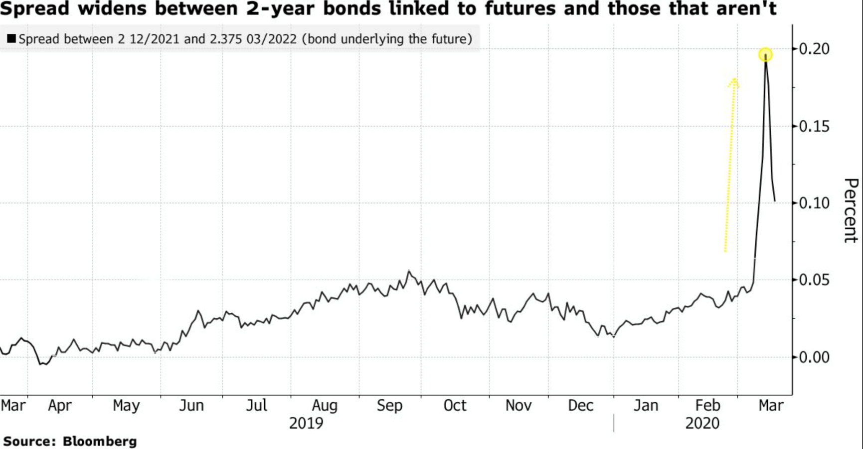
Market Insights: Treasury Futures “Basis Trades” (March 2020)
In mid-March 2020, as investors rushed to buy treasuries, they were able to get better execution in the futures market, as they were more liquid than the underlying treasuries, so spreads vs cash bonds widened out.
Traders with “basis trades” had to post margin, so they closed out positions to reduce risk and reduce the margining requirements (by buying treasury futures, selling bonds), which exacerbated the situation
Stephen Spratt, Bloomberg, March 17 “How a Little Known Trade Upended the U.S. Treasury Market“
https://www.bloomberg.com/news/articles/2020-03-17/treasury-futures-domino-that-helped-drive-fed-s-5-trillion-repo

Slide 8
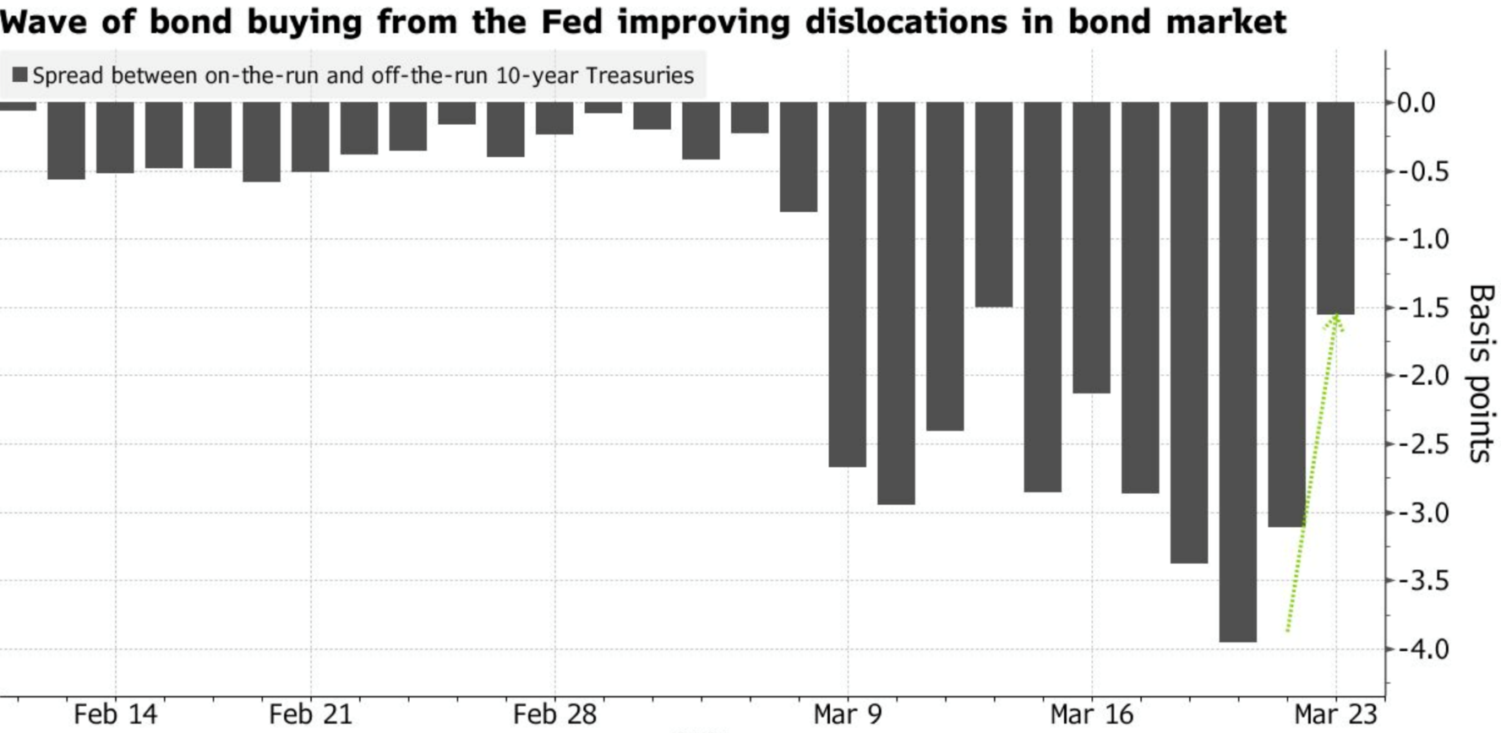
Market Insights: on-the-run vs off-the-run spreads (March 2020)
When investors (REITs, Hedge Funds) were liquidating their assets, including Treasuries and Pass Throughs, the decline in bond prices caused off the run Treasuries* and TBA prices to fall
To help stabilize the markets, the Federal Reserve Bank (FRB) bought Treasuries and Pass Throughs
Caused interest rates to fall and bond and MBS prices to rise
* more liquid current bonds are known as “on-the-runs” vs older so-called “off-the-run” securities

Slide 9
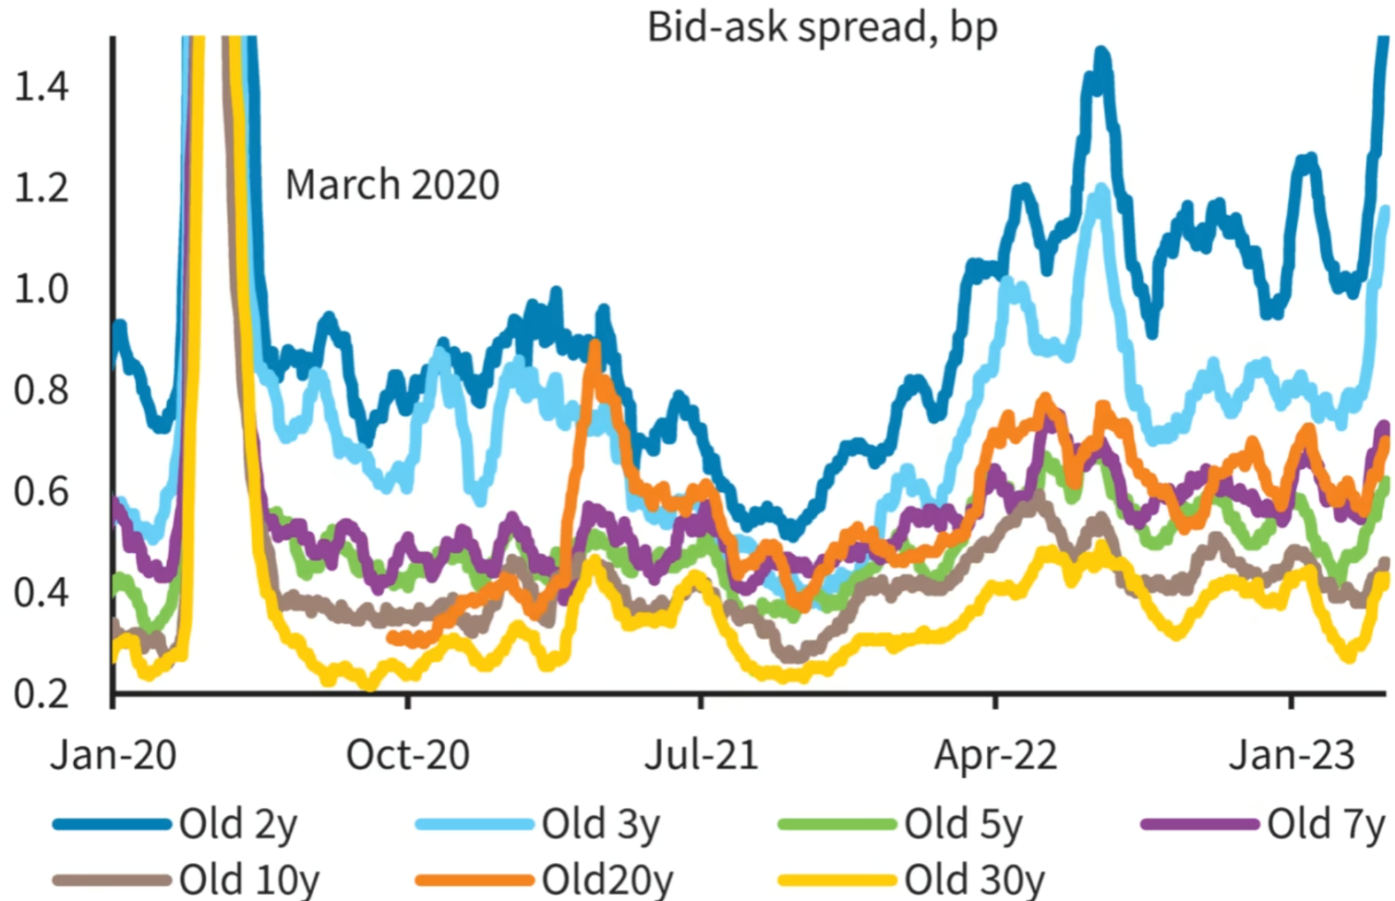
Market Insights: on-the-run vs off-the-run spreads (2020 to 2023)
On-the-run vs off-the-run spreads widened in 2023, but not as much as in 2020
Source: https://www.ft.com/content/5b5dacde-1a59-499b-acfd-e9a856b43255

Slide 10
Homework review
Scenario Analyses:
WAL for an amortizing mortgage is ~ half the final maturity
Cumulative Interest Paid: very sensitive to Coupon and Maturity

Slide 11
More about Agency Pass-throughs
The servicer* collects interest and principal from borrowers.
e.g. 6.65%
Servicer retains a portion of the interest component
servicing fee
e.g. 0.25%
GSE retains a portion of the interest component
guarantee fee
e.g. 0.40%
Investor receives the “pass-through” rate
e.g. 6.0%
Mortgage #1
Pool
Pass-Through
Mortgage #2
10,000 mortgages
Security
Mortgage #3
Investors
Mortgage #10,000
Principal cashflows to Investors = Principal paid by borrowers = principal paid into the passthrough
Interest cashflows to Investors = Interest CFs FROM mtgs – servicing - g-fee
* The “servicer” is responsible for collecting interest and principal payments from borrowers. The bank that originated the mortgage may be the “servicer” of the mortgage, but this role could be taken on by a different party.

Slide 12
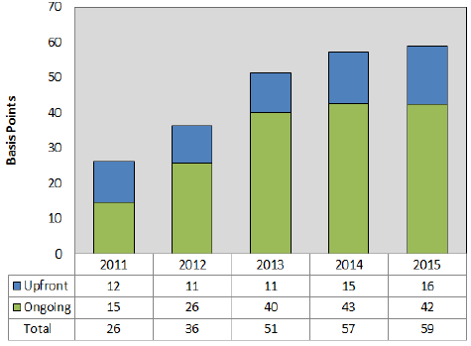
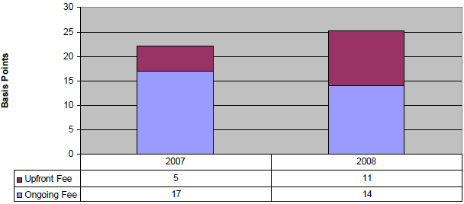
Agency G-fees
Single-Family G-fees
Question – what should influence the size of the guarantee fee?
Sources: https://www.fhfa.gov/AboutUs/Reports/Pages/Fannie-Mae-and-Freddie-Mac-Single-Family-Guarantee-Fees-in-2007-and-2008.aspx
https://www.fhfa.gov/AboutUs/Reports/Pages/Single-Family-Guarantee-Fees-in-2015.aspx

Slide 13
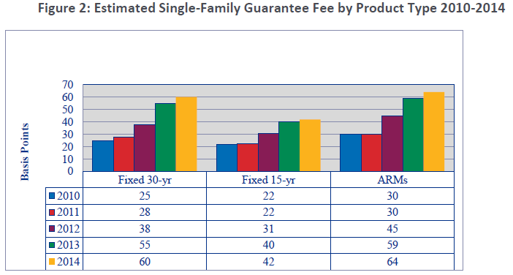
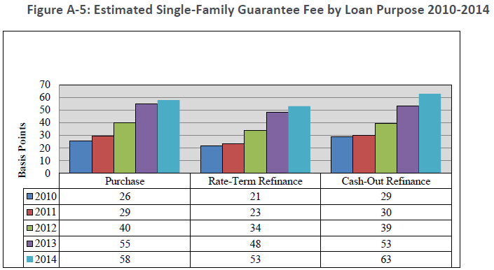
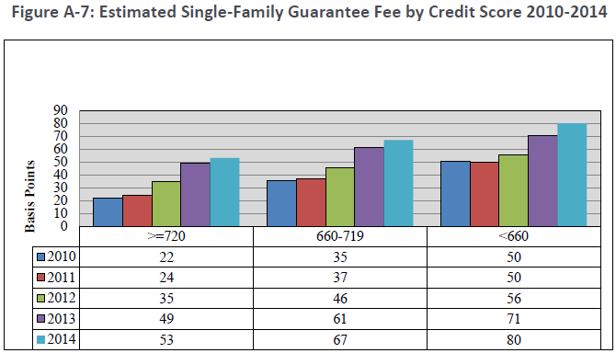
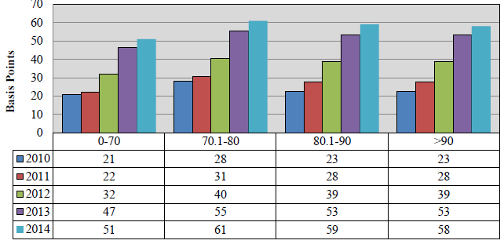
Agency G-fees
Breakout Rooms
Function of loan-type, loan purpose, FICO, LTV
Fees: ARM > 30yr > 15
Fees: Purchase > Refi < Cash-out Refi
Fees: LTV below 70 < LTV above 70
Fees: Higher FICO score < Lower FICO score

Slide 14
Conforming Loans
Fannie Mae and Freddie Mac are restricted by law to purchasing single-family mortgages with origination balances below a specific amount, known as the “conforming loan limit” (CLL) value. Loans above this amount are known as jumbo loans.
Limit values 50 percent higher for four statutorily-designated high cost areas: Alaska, Hawaii, Guam, and the U.S. Virgin Islands. Since 2008, various legislative acts increased the conforming loan limit values in certain high-cost areas in the United States. A permanent formula was established under the Housing and Economic Recovery Act of 2008 (HERA).
Detailed explanation: https://www.fhfa.gov/DataTools/Downloads/Pages/Conforming-Loan-Limit.aspx
Data: https://www.hsh.com/mortgage/a-history-of-conforming-fanniefreddie-loan-limits.html Conforming Loan Limit 2023.xls

Slide 15
TBAs (“To Be Announced”)
TBA pools
The underlying mortgages in the pool must meet certain criteria
Conforming loan limits
Credit quality (e.g. LTV, FICO, etc.)
Six variables are agreed upon in a TBA trade:
Issuer
Maturity
Coupon
Settlement date
Face*
Price
Detailed pool characteristics are not known prior to settlement
Standard settlement: once a month
Enhances liquidity by commoditizing MBS pass-throughs
* Also referred to as “Par” amount, Notional, Balance, Unpaid Balance (“UPB”)

Slide 16
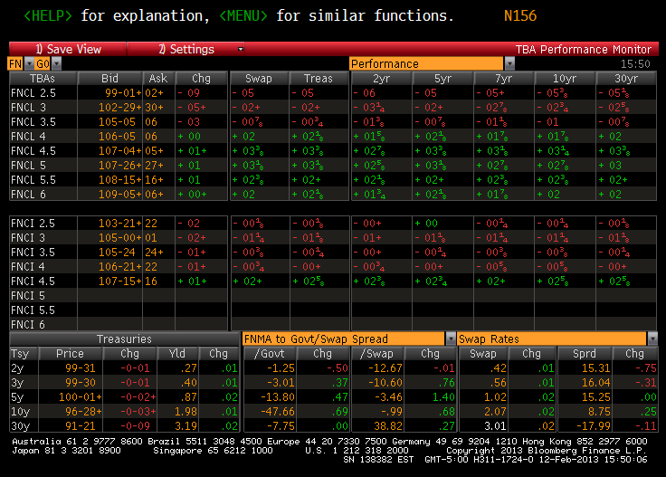
Coupon Stack

Slide 17
“Rate Lock” interest rate risk
When a bank originates mortgages, one step is to provide a “rate lock” to the borrower (Home Buyer)
A “rate lock” is the level of the interest (coupon) that the borrower will have to pay on the mortgage
But it usually takes weeks from the time the bank provides a “rate lock” till the time the bank provides to the money to the borrower (“close the loan”)
During these weeks, the bank has interest rate risk, and the bank has to hedge this interest rate risk?
How can the bank use TBAs to hedge this interest rate risk?
Short TBAs
Breakout Rooms

Slide 18
How a Mortgage Originator uses TBAs to hedge interest rate risk
The mortgage originator may short TBAs
If interest rates rise
The value of the mortgages will decline, but the value of the short TBA will rise
If interest rates fall
The value of the mortgages will rise, and the value of the short TBAs will fall

Slide 19


TBAs – how counterparty credit risk is mitigated
To reduce counterparty credit risk, TBAs are either
traded “bi-laterally”, and subject to margin, or
“cleared” at a Central CounterParty (CCP)
In this case, at FICC*
The CCP guarantees the performance of each counterparty
Each participant must post margin to the CCP as prices change
* FICC (Fixed Income Clearing Corporation), part of DTCC (The Depository Trust and Clearing Corporation)

Slide 20
TBAs vs Mortgages -- Funding risk!
Mortgage originators
Have to post margin on their TBA positions, BUT
Borrowers (Home buyers) who have a “rate lock” do not have to post margin!
In February and early March 2020, because MBS prices rose rapidly, TBA prices rose
Mortgage originators had liquidity issues because
Had to post more margin (put up more cash) as TBA prices rose
But there is no margining on “rate locks” provided to borrowers
* FICC (Fixed Income Clearing Corporation), part of DTCC (The Depository Trust and Clearing Corporation)

Slide 21
REITs liquidating positions
REITs (Real Estate Investment Trust) are publicly traded companies with different business models involving real estate
E.g. buy commercial buildings or apartment buildings and collect rent
One business model is buying MBS securities and funding them by “repo”
In later March 2020, When MBS prices fell, the counterparties either required more MBS collateral or provided less funding
REITs have had to liquidate positions (putting additional pressure on prices)
New Residential Investment Corp (RITM): liquidated billions in mortgages ¹
AG Mortgage Investment Trust (failed to meet margin calls) ²
Cherry Hill Mortgage Investment Corp (CHMI) has lost money on “CRT” securities
We will learn more about CRT (Credit Risk Transfer) securities in a subsequent lecture
1: https://therealdeal.com/new-york/2020/04/07/sharks-circle-as-mortgage-lenders-shed-portfolios-at-steep-discounts/
2: https://www.agmortgageinvestmenttrust.com/news-releases/news-release-details/ag-mortgage-investment-trust-inc-provides-update-status

Slide 22
Specified Pools (similar to TBAs, but with more information)
Mortgages can also trade on a specified-pool basis (“spec pool”) where the investor knows many more details about what he will get. For example:
Size of average loan balance
Loan-to-Value (LTV)
FICO scores
etc
Question: would the price of a specified pool that is deliverable into a TBA contract be
more or less than
the price of that TBA with the same five parameters?
(issuer, maturity, coupon, settlement date)
More than or equal to
Source: L. Gauttier

Slide 23
TBAs vs Specified Pools
“Cheapest to deliver” strategy
No pools that are deliverable into a TBA contract will trade cheaper than TBAs because if they did trade cheaper, then the trader would instead choose to deliver them as TBAs
Some specified pools trade at a premium to TBA securities –usually due to convexity enhancing characteristics

Slide 24
Valuation (ignoring the impact of prepayment)
A discount rate is a combination of
base rate, usually linked to a bond’s underlying interest rate risk
an incremental spread that compensates for default risk, cash flow variability, liquidity and other risks.
1) Simple approach:
Discount every cash flow using the same interest rate.
Internal Rate of Return or Yield-To-Maturity approach.
Employs a “Nominal Spread” over a benchmark yield
2) More sophisticated approach:
Every cash flow is discounted using a unique rate.
The benchmark rates would be zero-coupon rates plus
Cash Flow Spread or Static Spread (e.g. “Z-Spread” or a “zero-volatility spread”)
3) Most sophisticated approach:
Option Adjusted Spread (“OAS”)
The next several slides focus on #1 and #2. In a later lecture we will work with monte-carlo OAS

Slide 25
1) Simple: IRR or YTM approach
The price of a cash flow can be expressed as a function of time, the discount rate, and the frequency of compounding.
If the discount rate over a period of time is y (eg .06, or 6%), and interest is compounded each period, the value of $1 received in one period is $1/(1+y)^1
PV of $1 received in two periods is $1/(1+y)^2;
PV of $1 received in n periods is $1/(1+y)^n
Then the PV of a series of Cash Flows Cf_{i} is:

Slide 26
Simple: Explanation of Equivalent Yields
Bond yields are typically quoted on an annual basis, with semi-annual compounding. However, ABS, MBS cash flows are typically monthly.
So, if you are given a bond yield, and have to discount ABS or MBS cash flows, you will need to convert the Bond Equivalent Yield (BEY) into a Monthly Equivalent Yield (MEY).
The MEY is the yield that when compounded monthly has the same effective yield as the BEY:
Given the bond price, can solve for MEY and calculate the BEY as follows:

Slide 27
Simple: Nominal Spread
Often, the yield of non-callable investment-grade bonds are quoted in terms of a “nominal spread” over a yield curve. For example “Treasuries plus 50”
For example, a bond may be quoted based on a spread over Treasuries, or over Swaps
It may use a Treasury whose maturity is close to the WAL of the MBS
If the benchmark Treasury yield is 4% and the MBS BEY is 6%, the nominal spread over treasuries is 2% or 200 basis points
Shortcomings of discounting using a nominal spread: This simple approach fails to
Incorporate the effect of the shape of the yield curve
Take into account the impact of interest rate volatility on valuation
Take into account difference between the cash flow profile of a bullet bond versus the profile of an amortizing bond

Slide 28
Simple Nominal Spread Shortcoming: Shape of the Yield Curve
The “Nominal Spread” may overestimate or underestimate how much the investor is compensated for taking corporate bond risk if the maturity of the Treasury does not match the maturity of the corporate. For example, Corporate: 2.5yrs, and benchmark Treasury: 2yrs.
Assuming, we handle this properly, what else might be a problem?

Slide 29
Simple Nominal Spread Shortcoming: Interpolate the Yield Curve
Bonds with maturities between two benchmarks are often priced to an interpolated yield. The yield curve usually is not a straight line.
Assuming we handle this properly, what else might be a problem?

Slide 30
Simple Nominal Spread shortcoming: Shape of the Yield Curve
The Nominal Spread approach discounts all cash flows at the same yield
But, if the yield curve is upward sloping, then the zero coupon curve is upward sloping, and the Nominal spread approach will
Discount earlier cash flows at too high a discount rate
Discount later cash flows at too low a discount rate
The Cash Flow (static) spread approach discounts every cash flow at a unique yield

Slide 31
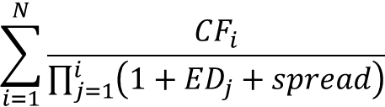
2) More sophisticated: Cash Flow Spread or Static Spread
The cash flow spread adds a spread over the yield corresponding to each individual cash flow.
The cash flow spread: the number of basis points added to or subtracted from each spot rate to make the present value equal the bond price.
Z-Spread: cash flow spread to treasury zero coupon rates
E-Spread: cash flow spread to Eurodollar futures curve (IMM)
(1)
$$\sum_{i=1}^{N}{\frac{{CF}_{i}}{\prod_{j=1}^{i}{\left(1+{ED}_{j}+spread\right)}}}$$

Slide 32
Risk Sensitivities (ignoring the impact of prepayment)
How much does the bond price change when rates move? Two steps:
1) Macaulay Duration for a bond with known cash flows is the Present-Value-Weighted Average-time to each Cash Flow
Duration is typically expressed in years
Source: C. Mohebbi

Slide 33
Modified Duration
2) Modified Duration: is the change in the price of a bond divided by the change in interest rates (e.g. 1 basis point, or .01%)
For example, if rates increase by 1 basis point, and if the bond price falls by two-hundredth’s of a percent (e.g. from 100 to 99.98), the modified duration is 2
(2)
Source: C. Mohebbi
* if semi-annual compounding, then the number of compounding periods is 2

Slide 34
Modified Duration and Convexity
Mod Dur and Convexity can be utilized in a Taylor Series expansion to estimate change in bond price for a given change in yield
Trader lingo -- when traders say:
“Duration”, they really mean “Modified Duration” (in yrs)
“DV01” or “PV01” *, they mean the Dollar Value change (or Present Value) change in a bond for a 1 basis point change in rates.
* For the purposes of this course, “PV01” means change in PV for a +1 bp change in interest rates. Some firms use a +1bp shock. Some firms use a -1bp shock.

Slide 35
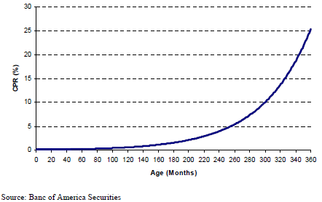
Prepayment and Curtailment
Prepayment*: homeowner pays off entire mortgage
Curtailment: partial prepayment
Behaviorally, curtailment is low initially; faster as time passes.
Why?
* Note: Sometimes I will use the word Prepayment to mean paying off the entire mortgage. Sometimes I’ll use it to include both partial prepayment, and complete retirement of the mortgage. For example, when talking about “speeds”

Slide 36
Curtailment
For a fixed rate mortgage, the size of the required monthly payment does not change even if there has been curtailment in previous months!
Consequently, curtailment shortens the life of the mortgage
After a curtailment, if the borrower only pays the required monthly amount from that point onwards, Interest expense each month from that point onwards is smaller than originally calculated; principal repayments are larger than originally calculated

Slide 37
Prepayment Measures
The Most common measures for prepayment “speeds”: SMM, CPR, PSA
SMM “Single Monthly Mortality”: Amount of principal payments above the scheduled amount during a month relative to the pool’s balance at the beginning of the month expressed as a percentage:
CPR “Conditional Prepayment Rate”: an annualized measure (assuming prepayments are constant through the year). Some quote CPRs in percents: “20% CPR”; some quote unit-less: “20 CPR”
FYI: The number of months it takes for a 6.5% 30-year mortgage to paydown to factors of 0.75, 0.50, 0.25 & 0.00

Slide 38
Clarification of “unscheduled” principal payments
Regarding the first formula on the previous slide, keep in mind that:
Unscheduled principal payment is the difference between the total principal payment that month minus the scheduled principal payment that month
As noted a few slides ago, the amount of scheduled principal payment in a given month is impacted by curtailments prior to that month because:
The required monthly payment “B” is calculated at the time a mortgage is originated, and this amount does not change throughout the life of the mortgage*
If there has been curtailment in the past, then
The remaining balance M_{k-1} is smaller (than if there had never been curtailment)
The interest portion “I” this month will be smaller (than if …)
The scheduled principal portion of the required monthly payment will be larger (than if …)
The Scheduled Balance is smaller (than if …)
* except for the last payment, because if there has been curtailment, it is almost certain that the last payment will be smaller than the required monthly payment

Slide 39
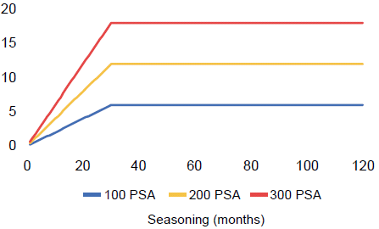
PSA Prepayment Vector
PSA (“Public Securities Association”). A prepayment speed of 100 PSA is a CPR vector that ramps up from 0.2% CPR to 6% CPR over 30 months as a function of seasoning, and then is constant at 6% for the remainder of the life
Often expressed unit-less as a multiple of the base-case PSA vector e.g. the 200 PSA vector is twice as large as the 100 PSA vector

Slide 40
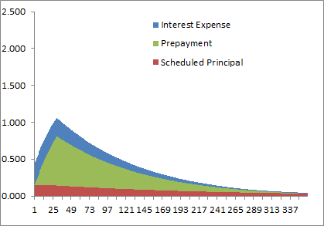
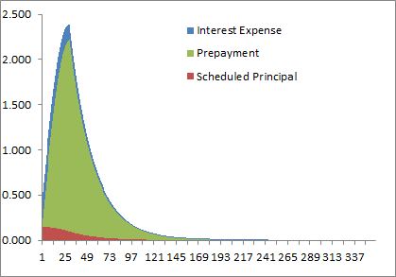
Effect of prepayment on WAL
The average life on a newly issued mortgage is expected to be around 7 years
Faster Prepayments accelerate the cash flows / become much more front-loaded when speeds increase
150% PSA (9 CPR after 30 months)
600% PSA (36 CPR after 30 months)

Slide 41
The Impact of Interest Rates on Prepayment and on Convexity
Prepayments are correlated with interest rate movements
Rates fall: homeowners refinance their mortgages
Rates rise: refinancing decreases and prepayments slow down
Prepayments cause negative convexity in Pass-Through securities
As rates fall, principal is received earlier (contraction) and reinvested at a lower rate
As rates rise, slower prepayments (extension) lead to less reinvestment when yields are higher
Changes in prepayment rates dramatically affect the duration of mortgage backed securities

Slide 42
Additional factors that affect prepayment speeds
Other factors that affect prepayment speeds:
Seasonality (what month of the year)
Seasoning (the age of the loan)
WAC (Weighted Average Coupon)
Loan Size
FICO
LTV (Loan to Value)
Geography
Investor-owned vs Owner-Occupied
Turnover
(we will cover these topic in detail in lecture 3)

Slide 43
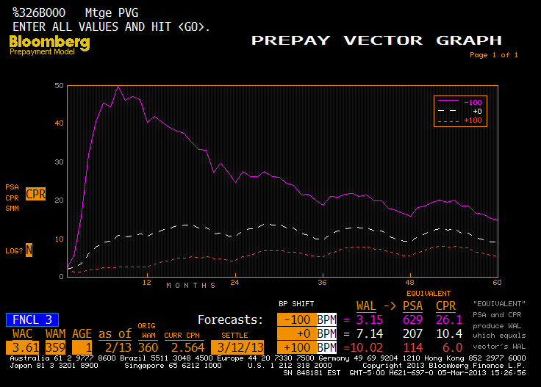
Comparison of Prepay Vectors
FNCL 3.0 TBA, 1 mth WALA (Weighted Average Loan Age)
Breakout Rooms

Slide 44
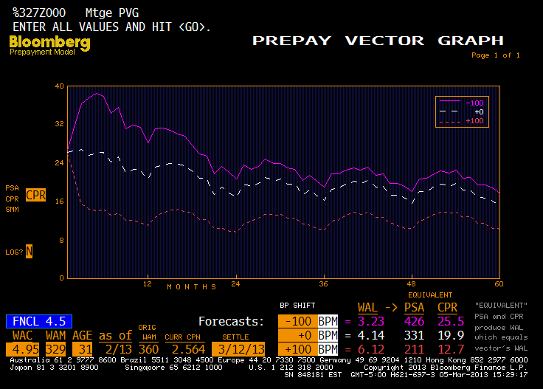
Comparison of Prepay Vectors
FNCL 4.5 TBA, 31 WALA
Breakout Rooms

Slide 45
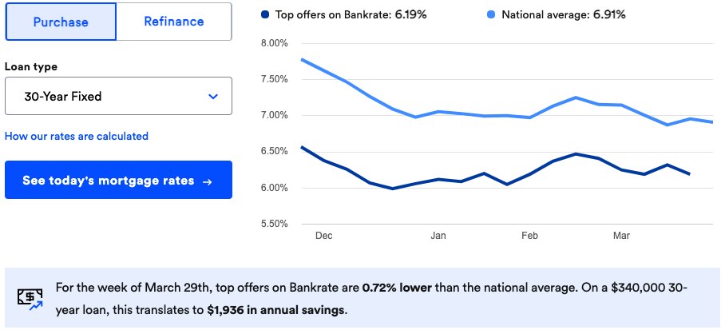
Mortgage Rates –National averages March 2024 (30 year fixed)
Source: https://www.bankrate.com/mortgages/15-year-mortgage-rates/

Slide 46
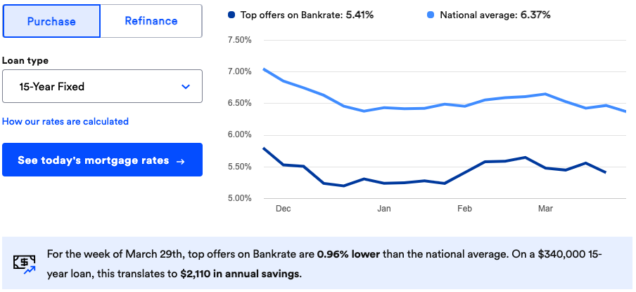
Mortgage Rates –National averages March 2024 (15 year fixed)
Source: https://www.bankrate.com/mortgages/15-year-mortgage-rates/

Slide 47
Homework
Build a Pass-through composed of three pools of loans, containing a total of 10,000 loans. Each loan, when originated, was exactly $100k in size.
All the loans in a pool have identical characteristics:
Pool 1: 1,000 loans are 15yr fixed-rate 6.40% WAC, 1 months WALA, SMM 0%
Pool 2: 7,000 loans are 30yr fixed-rate 6.80% WAC, 0 months WALA, SMM 1%
Pool 3: 2,000 loans are 30yr fixed-rate 7.70% WAC, 3 months WALA, SMM 2%
Note that the issuance of the Pass-though occurs months after the loans were originated. When calculating the impact of prepayment/curtailment, assume:
Pool 1 borrowers have no prepayment/curtailment
Pool 2 borrowers just prepay entire loan (nobody curtails). Each month, round down the number of borrowers to a whole number, e.g. in the first month, 70 prepay, leaving 6930 borrowers. The next month 69 borrowers prepay, not 69.3!
Pool 3 borrowers just curtail (nobody prepays the entire loan, except for the very last payment).
Assume the servicing fee + g-fee is 75bps.
For each pool, and each month, calculate the unpaid balance, scheduled principal payments, unscheduled principal or curtailments, interest expense, WAC, WAL, SMM.
Calculate the same metrics for the pass-through, and calculate the net coupon each month.
Explain the drivers of trends in WAC, WAL, SMM

Slide 48
Appendix
Interesting stuff

Slide 49
Simple vs More Sophisticated: YTM versus Z-Spread
Consider an example with a 3y bullet priced at par.
Table on top right illustrates the treasury YTM and spot term structures.
The bottom table illustrates how each cash flow is discounted at the maturity specific spot rate plus a 20 bp spread that equates the present values.
Each method produces a similar result. For a bullet bond, priced near par, using a benchmark close to its maturity, cash flow spreads will be very close to the nominal spreads.
Source: C. Mohebbi

Slide 50
Comparing the Alternatives – Z-Spread
Next, consider two bonds with different maturities:
One has 30mth mty, offered at UST 3y + 10.
The other has a 42m mty, offered at UST 3y + 25.
Using Z- spreads, the first bond offers the better value of the two because the YTM of the benchmark doesn’t provide enough compensation to offset the longer average life of Bullet #2.
Source: C. Mohebbi

Slide 51
APPENDIX: Amounts Issued
FNMA 30yr Fixed

Slide 52
Amounts Issued
FNMA 30yr Fixed

